Slide 1

Project Title: The Practical Aspects of Text Classification of Identifying Offensive and Non-offensive Speech
Text Classification
Analysis
Presented by: Murphy Ogbeide
Source: World Bank

Slide 2



What is our presentation about?
It is about identifying offensive speech in a well-balanced dataset using machine learning models.
It is also about comparing the performance of the Random Forest Classifier and the Decision Tree Classifier in classifying speech as informative or non-informative.
Lastly, it is about the insights gained from the analysis and their implications for developing effective moderation policies for online platforms.

Slide 3

How did we clean the data?
The text in the dataset was converted to lowercase to ensure consistency.
Non-alphanumeric characters and URLs were removed from the tweet column as they are not useful for analysis.
Stopwords were removed, lemmatization and stemming were applied to the text to reduce it to its root form, and the cleaned text was returned.

Slide 4
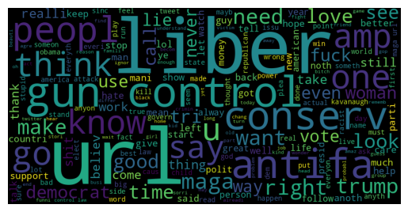
A WordCloud to visualize the most common words in the 'clean tweet' column of the train dataset
"url", "liber", "gun", "control", "conserv", and "think" are the most common words in the train dataset's clean_tweet column.
These words suggest that the tweets are likely related to political or social issues, specifically around gun control.
The words "liber", "control", and "conserv" imply a political leaning, possibly towards liberal or conservative viewpoints.
The presence of these words suggests that the dataset contains tweets related to controversial and polarizing topics, which may contribute to the occurrence of offensive speech.

Slide 5
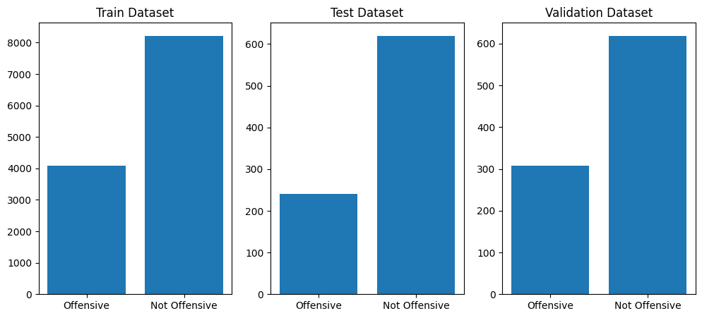
Highlights of the identification offensive and not offensive tweets.
The training dataset has a larger sample size compared to the test and validation datasets.
The difference in the number of offensive tweets could be due to sampling or the rarity of offensive tweets.
This suggests a larger proportion of non-offensive tweets on social media and highlights the difficulty in identifying offensive tweets for content moderation policies.

Slide 6
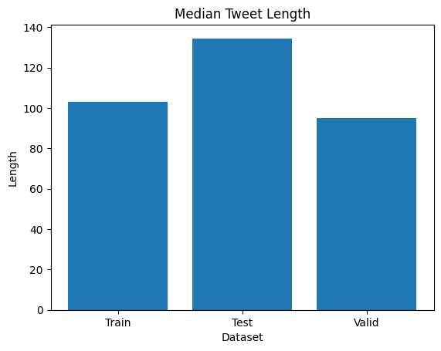
Median distribution by tweets across the datasets
Test dataset tweets are generally longer than those in the training and validation datasets, which could affect machine learning models.
The difference in median tweet length may be due to the source or time period from which the test dataset was collected.
The variation in tweet length across social media platforms and time periods highlights the importance of training and evaluating natural language processing models accordingly.

Slide 7
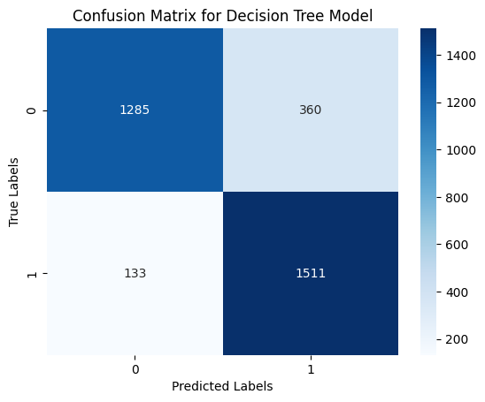
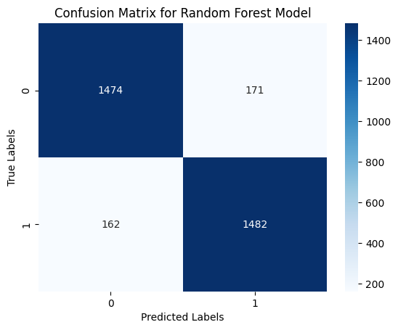
Confusion Matrix on the two selected models
The confusion matrix shows how false positives and false negatives impact a model's performance in correctly classifying positive and negative instances.
Performance metrics and model evaluation are important for selecting the best model to accurately identify offensive tweets. And from the look of things, the random forest model seems to be the best.

Slide 8
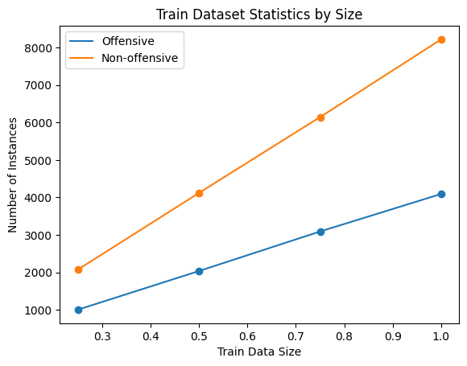
Distribution of Offensive and Non-Offensive Tweets in the training dataset for different sizes
Having a larger and more balanced training dataset can lead to better model performance and more accurate classification results in real-life scenarios.
This plot can be applied to real-life scenarios where machine learning models are used to classify text data, such as identifying offensive tweets or comments.
Understanding the distribution of offensive and non-offensive instances in the training dataset can help in designing effective data collection and pre-processing strategies to improve model performance.

Slide 9
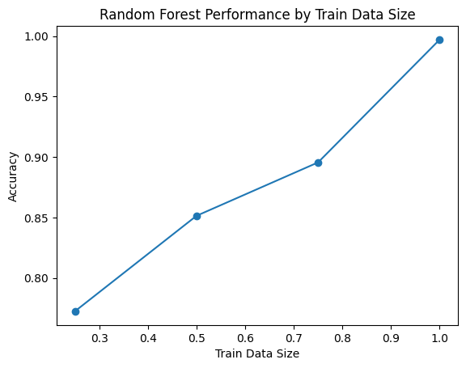
Random Forest Performance by the Train Data Sizes
The plot shows that the Random Forest model's accuracy increases with larger training dataset sizes.
The model achieves high accuracy (0.9972) when trained on a dataset of size 1, indicating the importance of a large and balanced dataset..

Slide 10
What does our analysis say?
The Random Forest Classifier outperforms the Decision Tree Classifier in identifying offensive speech in terms of accuracy and generalization ability.
Developing robust models is crucial for a better user experience and maintaining a safe and healthy online environment.
Computational resources and model complexity should be considered when determining the optimal training data size.

Slide 11
What do we recommend based on these findings?
We recommend using Random Forest Classifier for identifying offensive speech in a well-balanced dataset.
Consider factors such as interpretability, computational efficiency, and generalization performance when selecting a model.
Increasing the amount of training data can improve the model's performance, but balancing the training and test data size is crucial to avoid overfitting.

Slide 12

Thank you!!!

